Slide 1
DIGITAL IMAGE PROCESSING · FINAL PROJECT · STAGE 3
Image Denoising:
How the Field Actually Evolved
Not ten papers in order. One technical story: what each method could not do, what the next one changed, and which line of code changed to do it.
THE QUESTION
ANCHOR PAPER
PRESENTERS
REFERENCE
Why did each innovation have to be invented?
DnCNN — Zhang et al. IEEE TIP 26(7), 2017
Navid Zare · Ali Ahmadi · Komeil Khodayar
100-slide master deck, submitted separately
brief §3 · full evidence in the master deck

Slide 2
02
THE SHAPE OF THIS TALK
Four questions we will ask about every method
Each algorithm gets the same four-part treatment, so the comparison between them is structural rather than anecdotal. The methods that were state of the art get a fifth.
1
What could the previous method not do?
2
What changed technically?
Every innovation in this field was a response to a named, measured failure — usually named by the paper that fixed it, which is what makes this timeline evidenced rather than imposed.
The algorithmic change: a different prior, a different training target, a different operator. Stated precisely enough that you could implement it.
3
Which line of code changed?
4
What did it buy, and what did it cost?
A Before → After from the reference implementations. Contribution → algorithmic change → implementation change → measured improvement, as one chain.
The measured improvement, the applications it opened, and the new limitation it created — because every step in this story created the next problem.
5
And for the SOTA methods, a fifth: what made it state of the art, on which benchmark and in which years — and why it did not make the others obsolete.
brief §3 — the structure of this presentation · anchor paper: DnCNN17
2007
2014
2017
2022
2025

Slide 3
03
THE PROBLEM
One equation, three unknowns, eighteen years
Given only y, infinitely many splits into x + v are arithmetically valid. Every method in this talk supplies the missing information in a different way — that supplied information is called the prior, and the whole story is about where it lives.
y = x + v
y — what the sensor produced · x — the clean image we want · v — the noise
01
The classical answer writes the prior down as a formula: minimise ½‖y − x‖² + λ·Φ(x). You can read Φ, differentiate it, and argue about it.
02
The deep answer replaces Φ with a tensor of learned weights. You cannot read it, but you can download it — and it runs in 60 ms.
03
The self-supervised answer takes the prior partly from the test image itself, so no clean data is needed at all.
04
Where the prior lives, and who writes it, is the single axis this whole talk runs along.
DnCNN17 §I — standard MAP formulation
2007
2014
2017
2022
2025

Slide 4
04
GROUND RULES
What state of the art means in this talk
The phrase is used loosely in most presentations. We attach three qualifiers to it, because that is what makes the SOTA comparison later in the talk meaningful rather than rhetorical.
A SOTA CLAIM NEEDS THREE THINGS
WHICH IS WHY THERE IS NO SINGLE WINNER
1
A benchmark and a metric. Best denoiser is meaningless. Highest PSNR on BSD68 at σ=25 is a claim you can check.
Different benchmarks measure different capabilities: BSD68 measures average-case Gaussian removal, Urban100 measures long-range self-similarity, SIDD measures real sensor noise.
2
A comparison protocol. Two papers reporting on the same dataset can still disagree, so wherever a row compares two methods we take both numbers from one table.
A method can lead one and trail another. Restormer, NAFNet and MambaIR each lead a different table today.
3
Honesty about what is not reported. No paper here states how long it held a position, so this talk does not claim SOTA windows — only the publication date and which table each method leads.
We return to this on slide 37 with the numbers, because why there are several SOTAs is the question this talk is built to answer.
benchmark definitions: DnCNN17 §I, §III · Restormer22 §4.1 · NAFNet22 §4.1
2007
2014
2017
2022
2025

Slide 5
05
HOW WE MEASURE
Three numbers, three opinions — why PSNR alone is not enough
The brief asks for PSNR, SSIM and perceptual metrics side by side. This talk reports PSNR because its sources do — but every PSNR claim names its table and its σ. This slide is why that discipline matters.
PSNR
SSIM
LPIPS
PSNR = 10·log₁₀( MAX² / MSE )
SSIM(x,y) = ((2μ_{x}μ_{y} + c₁)(2σ_{xy} + c₂)) / ((μ_{x}² + μ_{y}² + c₁)(σ_{x}² + σ_{y}² + c₂))
d(x, x̂) = Σ_{l} ‖w_{l} ⊙ (F_{l}(x) − F_{l}(x̂))‖² / (H_{l}·W_{l})
Pixel-wise fidelity in decibels. Optimal for the conditional mean — which is smoother than any plausible clean image. Two visibly different images can share one PSNR.
Distance in calibrated deep-feature space. Matches human judgment; standard in super-resolution, absent from denoising leaderboards.
Structure-aware: luminance, contrast, correlation. Catches blur that PSNR forgives; still a low-level metric.
01
Noise2Noise names the mechanism itself: “L2 training results in spatial blurriness.” While leaderboards rank by PSNR, the incentive points the wrong way. [N2N18 §2]
02
Our rule for the whole talk: every PSNR number is reproduced from a named table (DnCNN17 Table II, Restormer22 Tables 4–6 …) at a stated dataset and σ — never recomputed by us.
03
For applications the metric that matters is downstream: detection or segmentation IoU on denoised input. Denoising is preprocessing, not the product — see slide 40.
SSIM: Wang et al., IEEE TIP 2004 · LPIPS: Zhang et al., CVPR 2018 · N2N18 §2
2007
2014
2017
2022
2025

Slide 6
06
The Hand-Written Prior
1
01
BM3D — the baseline everything is measured against
02
WNNM — the classical ceiling
PART 1 / 5
03
Bottleneck 1 — why the era ended
BASELINE · 2007 – 2014
Where the field started: a formula a human wrote, re-solved from scratch for every image.
brief §2
2007
2014
2017
2022
2025

Slide 7
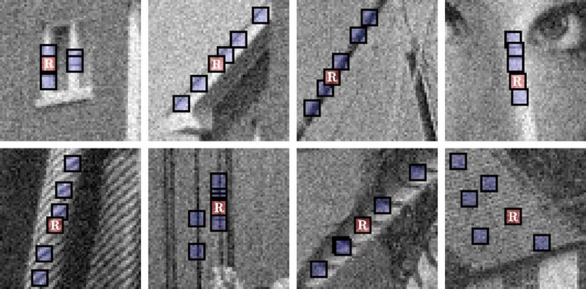
07
CLASSICAL DIP · BM3D · 2007 · THE BASELINE
The innovation: filter patches together, not alone
Dabov et al., IEEE TIP 2007. Previous transform-domain methods shrank each patch independently. BM3D groups similar patches first, creating a third axis along which the signal is nearly constant and the noise is not.
Block matching in practice: the reference patch R and the similar patches BM3D groups with it before collaborative 3-D filtering. [BM3D07 · Fig. 2]
WHAT CHANGED
Block-match similar patches into a 3-D stack, transform the stack, hard-threshold, invert, aggregate — then repeat using the cleaner estimate as a Wiener pilot.
WHY IT WORKS
The paper own ablation: even a transform that is random apart from the DC loses only 0.1–0.4 dB. The grouping does the work, not the transform. [BM3D07 §V]
BM3D07 §II-C, §V · DnCNN17 Table II, Table IV · baselines in N2N18, N2V19, ZS-N2N23
2007
2014
2017
2022
2025

Slide 8
08
CLASSICAL DIP · BM3D · 2007 · THE BASELINE
The innovation: filter patches together, not aloneCONTINUED
IMPACT
BSD68, σ=25: 28.57 dB at 2.85 s per 512×512 image [DnCNN17 Table II, Table IV]. Became the reference line every paper for a decade had to beat.
STILL IN USE
Appears as a live baseline in Noise2Noise (2018), Noise2Void (2019), ZS-N2N (2023) and Restormer (2022) — a seventeen-year-old algorithm is still what new zero-shot methods must beat, because it needs no training data.
APPLICATIONS
The zero-shot comparison in those same papers, and the fallback where there is neither training data nor a GPU. On real sensor noise it still beats an AWGN-trained DnCNN by 1.99 dB — BM3D 25.65 vs DnCNN 23.66 on SIDD, both from Restormer22 Table 6.
28.57 dB
2.85 s
+1.99 dB
BSD68 Σ=25
512×512
VS DNCNN ON SIDD
BM3D07 §II-C, §V · DnCNN17 Table II, Table IV · Restormer22 Table 6 · baselines in N2N18, N2V19, ZS-N2N23
2007
2014
2017
2022
2025

Slide 9
09
CLASSICAL DIP · WNNM · 2014 · BEFORE → AFTER
WNNM vs BM3D — the same grouping, a better estimator
Gu et al., CVPR 2014. WNNM keeps BM3D non-local grouping and replaces what happens to the group. The first clean Before → After in the story, entirely inside one step.
X̂ = argmin_{X} ½‖Y − X‖²_{F} + Σ_{i} w_{i}·σ_{i}(X), w_{i} ∝ 1/σ_{i}
the weighted nuclear norm: large singular values carry the image and are shrunk less [WNNM14 §3]
ASPECT | BM3D (2007) | WNNM (2014) | WHY IT MATTERS
Core algorithm | Group patches, shrink in a 3-D transform | Group patches, recover a low-rank matrix | Stacked near-copies are low rank by construction — a stronger structural assumption
Key innovation | Collaborative hard-thresholding | Weighted nuclear norm, wi ∝ 1/σi | Standard NNM shrinks all singular values equally
Implementation change | 3-D DCT + threshold | SVD per patch group + per-value shrinkage, iterated | One transform call becomes an iterated SVD — the entire cost difference
Performance | 28.57 dB · 2.85 s | 28.83 dB · 773.2 s | +0.26 dB for a 271× slowdown
Limitation | Fixed hand-set parameters | Non-convex; still per-image optimisation | Neither can reuse anything learned from one image on the next
Applications | General-purpose, real-time-ish | Offline / quality-critical restoration | The cost makes WNNM impractical for interactive or batch use
This row is the whole argument for what comes next. Seven years of hand-designed priors bought 0.26 dB on BSD68 at σ=25, and the best method became 271× slower than the second best. The era hit a wall in quality and cost simultaneously.
DnCNN17 Table II, Table IV · WNNM14 §3, Theorem 2
2007
2014
2017
2022
2025

Slide 10
10
CLASSICAL DIP · BOTTLENECK 1
Why the era ended — stated by the paper that ended it
DnCNN introduction names the classical era drawbacks in its own words. Quoting the paper that broke the bottleneck, rather than asserting it ourselves, is what makes this an evidenced timeline.
DRAWBACK 1
DRAWBACK 2
The prior is paid for once per image
The prior is written by hand
“Prior-based methods involve a complex optimization problem in the testing stage.” Nothing learned on image 1 helps image 2. WNNM: 773 s, every time. [DnCNN17 §I]
“The models are generally non-convex and involve several manually chosen parameters” — block size, thresholds, λ, different values above and below σ=40. [DnCNN17 §I]
DRAWBACK 3
DRAWBACK 4
Its form limits the ceiling
One model per noise level
“Performance is inherently restricted to the specified forms of prior.” You cannot exceed what your formula can express, however well you tune it. [DnCNN17 §I]
“Bridge methods train a specific model for a certain noise level and are limited in blind image denoising.” In a real camera, σ is never known. [DnCNN17 §I]
DnCNN17 §I — all four quoted from the paper introduction
2007
2014
2017
2022
2025

Slide 11
11
The Prior Becomes a File
2
01
TNRD — the bridge nobody skips
02
DnCNN — innovation, implementation, impact
PART 2 / 5
03
Bottlenecks 2 and 3
THE BREAK · 2016 – 2017
One architecture answers all four drawbacks at once — and creates the two problems the rest of the talk is about.
brief §3
2007
2014
2017
2022
2025

Slide 12
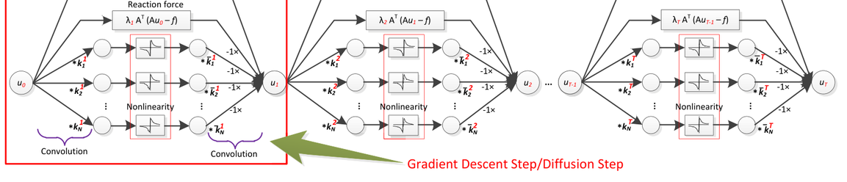
12
THE BRIDGE · TNRD · TPAMI 2017 · BEFORE → AFTER
Unrolling — the step that made the transition continuous
Chen & Pock, IEEE TPAMI 2017. Worth ninety seconds because it is the conceptual bridge: it shows that a classical optimiser and a neural network are the same object viewed differently, which is why the move to deep learning was not a rupture.
The diffusion network unrolled as a feed-forward graph: learned filters, trainable nonlinearity and reaction force applied at every stage. [TNRD17 · Fig. 1]
ASPECT | CLASSICAL OPTIMISER | TNRD (UNROLLED) | WHY IT MATTERS
Iteration count | Run to convergence, unbounded | Truncated to a fixed K (usually < 10) | Runtime becomes a constant — the first half of bottleneck 1 is gone
Parameters | Same hand-set rule every iteration | Every stage has its own learned filters and nonlinearities | The prior is no longer one formula; it is K different learned ones
What is learned | Nothing | Filters and influence functions, jointly, from data | Earlier diffusion models fixed the filters and chose the diffusivity
Implementation | while loop to a tolerance | A fixed stack trained by back-propagation | Structurally a CNN — well-suited for parallel computation on GPUs
TNRD17 (Chen & Pock, TPAMI) §1.2, §2, §3 · DnCNN17 Tables II, IV
2007
2014
2017
2022
2025

Slide 13
13
THE BRIDGE · TNRD · TPAMI 2017 · BEFORE → AFTER
Unrolling — the step that made the transition continuousCONTINUED
ASPECT | WNNM (CLASSICAL CEILING) | TNRD (UNROLLED) | WHY IT MATTERS
Performance | 28.83 dB · 773 s | 28.92 dB · 0.032 s (GPU) | Best quality-per-second of the era
Limitation | — | Still one model per noise level | Blind denoising remains unsolved
KEEP THIS IN MIND FOR THE NEXT SLIDE
DnCNN derives part of its own justification from a one-stage TNRD — the two are directly connected, not merely adjacent in time.
28.92 dB · 0.032 s
quality of WNNM at 1/24,000 of its runtime [DnCNN17 Tables II, IV]
TNRD17 §1.2, §2, §3 · DnCNN17 Tables II, IV
2007
2014
2017
2022
2025

Slide 14
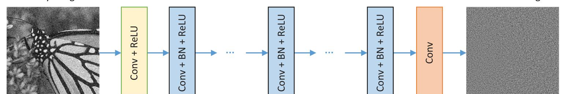
14
THE BREAK · DNCNN · 2017 · BEFORE → AFTER
DnCNN vs TNRD — remove the optimiser entirely
Zhang et al., IEEE TIP 26(7), 2017. TNRD unrolled the optimiser; DnCNN throws away the optimisation heritage and keeps only the network. The technical change is small; the consequence is the largest single step in this story.
The DnCNN architecture: Conv(+BN)+ReLU layers predict the residual noise, not the clean image. [DnCNN17 · Fig. 1]
ASPECT | TNRD (2017 TPAMI) | DNCNN (2017 TIP) | WHY IT MATTERS
Core algorithm | K diffusion stages, PDE-derived | Plain deep CNN: Conv-BN-ReLU ×17, no pooling | The architecture no longer has to resemble an optimiser at all
What the net outputs | The restored image | The noise — x = y − R(y) | Residual learning: the do-nothing solution moves to zero, which is trivially reachable
Key enabler | Learned influence functions | Residual learning + batch normalisation, together | Neither works nearly as well alone — the paper most-cited empirical finding
Noise levels | One model per σ | DnCNN-B: one blind model, σ ∈ [0, 55] | Drawback 4 solved; no noise estimate needed at test time
DnCNN17 §II-A, §III-A, §III-C, §III-D, Table II, Table IV · TNRD17
2007
2014
2017
2022
2025

Slide 15
15
THE BREAK · DNCNN · 2017 · BEFORE → AFTER
DnCNN vs TNRD — remove the optimiser entirelyCONTINUED
ASPECT | TNRD (2017) | DNCNN (2017) | WHY IT MATTERS
Performance | 28.92 dB · 0.032 s | 29.23 dB · 0.060 s (blind: 29.16) | +0.66 / +0.66 / +0.61 dB over BM3D at σ = 25 / 15 / 50 [DnCNN17 Table II]
Applications | Gaussian denoising | One model for denoising + super-resolution + JPEG deblocking | Redefine v and the same network solves three tasks [DnCNN17 §III-D, Table V]
+0.66 dB
12,900×
3 tasks
OVER BM3D · BSD68 Σ=25
FASTER THAN WNNM · 512×512
ONE MODEL, ONE LOSS
σ=15: +0.66 · σ=50: +0.61 — one paper took more than seven years of classical refinement (WNNM +0.26, TNRD +0.35, EPLL +0.11) [DnCNN17 Table II]
773.2 s CPU → 0.060 s GPU. The device differs and the paper says so; the order of magnitude is the point [DnCNN17 Table IV]
DnCNN-3 handles denoising, SR and JPEG deblocking, beating a specialist baseline on all three [DnCNN17 Table V]
DnCNN17 Table II, Table IV, Table V
2007
2014
2017
2022
2025

Slide 16
16
THE BREAK·DNCNN·THE IMPLEMENTATION CHANGE
The innovation is one line of code
cszn/KAIR, models/network_dncnn.py, by DnCNN own first author. The architecture is a list comprehension; the contribution is the return statement.
KAIR/models/network_dncnn.py — the whole network
m_head = B.conv(in_nc, nc, mode=…)
01
Why that one change matters. From ResNet: a mapping close to the identity is hard to optimise. And y is much more like x than it is like v — so learning the image forces the network toward an identity transform, which seventeen ReLU layers have no natural way to express.
m_body = [B.conv(nc, nc, mode=…)
for _ in range(nb-2)] # ← the entire network
m_tail = B.conv(nc, out_nc, mode=…)
02
Learning the noise moves the trivial solution to zero, reachable by driving weights toward zero. Same function class, far easier optimisation landscape.
def forward(self, x):
n = self.model(x)
03
The synergy, in one sentence. Residual learning strips the image out of the hidden layers, making activations Gaussian-like and content-independent — exactly the regime batch-norm batch statistics assume. Without residual learning, BN has a certain adverse effect on convergence. [DnCNN17 §III-C]
return x-n # ← the contribution
# BEFORE (discriminative CNNs, ~2012–2016):
Where the prior went. Nowhere in this file. It is in the .pth checkpoint this class will load — the moment the prior stopped being readable and started being downloadable.
# return self.model(x) → learn F(y) = x
04
# AFTER (DnCNN, 2017):
# return x - self.model(x) → learn R(y) = v
measured — cszn/KAIR, verbatim · DnCNN17 §II-A, §III-C
2007
2014
2017
2022
2025

Slide 17
17
THE BREAK·DNCNN·WHY IT WAS SOTA
What made it state of the art, and for how long
A SOTA claim with its qualifiers attached: the benchmark, the margin, and the context.
+0.66 dB
12,900×
3 tasks
OVER BM3D · BSD68 Σ=25
FASTER THAN WNNM · 512²
ONE MODEL, ONE LOSS
σ=15: +0.66, σ=50: +0.61. Seven years of classical refinement had bought +0.11–0.39 dB (EPLL, WNNM, TNRD); DnCNN took more in one paper. [DnCNN17 Table II]
773.2 s CPU → 0.060 s GPU. The device differs and the paper says so; the order of magnitude is the point. [DnCNN17 Table IV]
DnCNN-3 handles denoising, super-resolution and JPEG deblocking by redefining v, beating a specialist baseline on all three. [DnCNN17 §III-D, Table V]
01
And it did it blind. DnCNN-B reaches 29.16 dB at σ=25 without being told σ — within 0.07 dB of the noise-specific model. Drawback 4 closed. [DnCNN17 Table II]
02
Applications it opened: real-time denoising in imaging pipelines; the .pth checkpoint as a shippable artefact; denoising as a reusable plug-and-play prior inside other solvers. [SCUNet23 §1]
03
What it was not. On real sensor noise DnCNN was never the leader — 23.66 dB on SIDD [Restormer22 Table 6]. That gap is slide 41 subject (Open 1).
DnCNN17 Table II, Table IV, §III-D · SCUNet23 §1 · Restormer22 Table 6
2007
2014
2017
2022
2025

Slide 18
18
THE BREAK·BOTTLENECKS 2 AND 3
What DnCNN broke, and the two bills it left
This slide is the hinge of the whole talk. Everything after it is the field paying off these two debts — paid off by two different communities, independently, and never merged.
BOTTLENECK 2 — IT NEEDS CLEAN DATA
BOTTLENECK 3 — IT CANNOT SEE FAR ENOUGH
The loss is ‖R(y) − (y − x)‖². It requires x.
Receptive field is 35×35 pixels, chosen deliberately to match EPLL, the smallest effective patch size in the field [DnCNN17 Table I]. WNNM effective patch is 361×361.
For fluorescence microscopy, cryo-EM, MRI and astronomy a clean ground truth does not exist and cannot be acquired — you cannot photograph the same cell noiselessly.
Visible in DnCNN own Table III: on Barbara it loses to BM3D by 0.71 dB — the one Set12 image dominated by repetitive texture.
So the most valuable applications of denoising were the ones DnCNN could not serve.
The paper explains it: repetitive images meet well with the non-local similarity prior that a 35×35 convolution stack cannot reach.
→ Answered by Branch A — the data branch. Part 3, slides 21–26.
→ Answered by Branch B — the architecture branch. Part 4, slides 28–34.
A limitation visible in 2017, in the winning paper own results table, that took until 2022 to fix. That is what an honest evolution story looks like.
DnCNN17 §III-A Eq. (1), Table I, Table III · N2V19 §1
2007
2014
2017
2022
2025

Slide 19
19
HANDOVER·PRESENTER 2
2018: the field forks, and never merges
Two debts, two communities, two independent answers. Neither branch has adopted the other advance — which is itself one of the findings of this project, and the source of the open problem we end on.
BRANCH A · BOTTLENECK 2 — CHANGE WHAT THE NETWORK IS SHOWN
BRANCH B · BOTTLENECK 3 — CHANGE WHAT THE NETWORK IS
Noise2Noise → Noise2Void → ZS-N2N → P2N
Restormer, NAFNet, SCUNet, MambaIR
The architecture stays almost exactly where DnCNN left it; what moves is the training target. Each paper removes one more requirement until nothing is needed but the noisy image itself.
Supervision stays exactly as DnCNN had it — paired data, same loss family. What moves is the operator that replaces the 3×3 convolution.
THE EVIDENCE THEY NEVER MERGED — P2N SHIPS THE 2018 NETWORK
THE OPEN QUESTION — NOBODY HAS COMBINED THEM
In the official P2N repository the class is literally named UNet_n2n_un, with the 2018 Noise2Noise channel widths. Seven years, and the backbone is unchanged. [repository: Li-Tong-621/P2N-plus, measured]
As far as we found, no published work trains a Transformer or state-space backbone under self-supervised RDC/DCS supervision. We return to this as a concrete proposal on slide 42.
the structural claim of this project · repository: Li-Tong-621/P2N-plus [measured]
2007
2014
2017
2022
2025

Slide 20
20
3
BRANCH A · 2018 – 2025
Removing the Clean Image
PART 3 / 5
Noise2Noise — the statistical result
01
02
Noise2Void — the blind spot
03
ZS-N2N and P2N — down to one image
04
What self-supervision costs
Four papers, each removing exactly one requirement its predecessor could not drop.
brief §4
2007
2014
2017
2022
2025

Slide 21
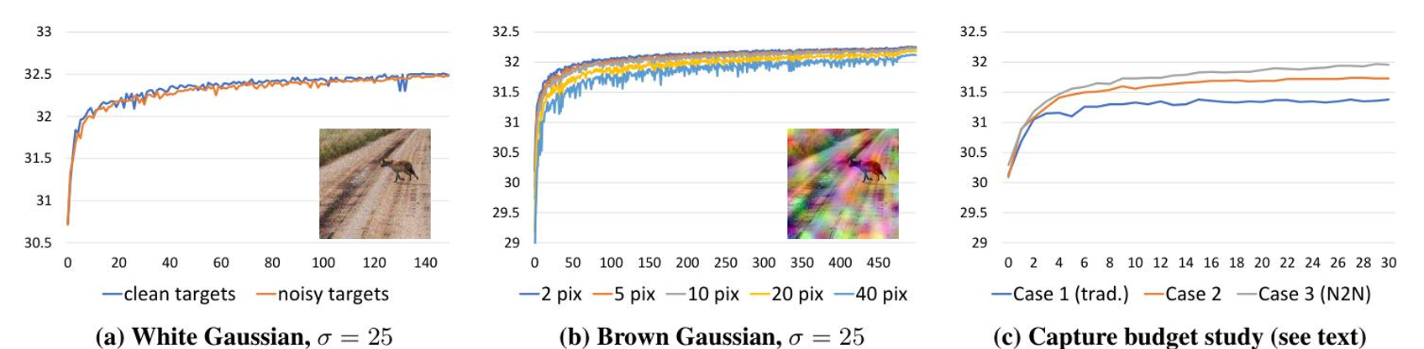
21
DATA BRANCH·NOISE2NOISE·2018·BEFORE → AFTER
A theorem worth one conditional
Lehtinen et al., ICML 2018. The most striking ratio in this story: a substantial statistical result whose implementation change is a single branch on which tensor becomes the target.
Noise2Noise own result: training on noisy targets (orange) tracks clean-target training (blue) almost exactly. [N2N18 · Fig. 1]
Given a noisy input and a corrupted target whose expectation equals the clean target, L2 regression converges to the same optimum — the corrupted target is a full substitute for ground truth. [N2N18 §2]
N2N18 §2, Eq. (2)–(6), Table 1
2007
2014
2017
2022
2025

Slide 22
22
DATA BRANCH·NOISE2NOISE·2018·BEFORE → AFTER
A theorem worth one conditionalCONTINUED
THE CHANGE, IN ESSENCE
Why it works. L2 regression learns the conditional mean of the target. The paper states the consequence as a triviality: on expectation, the estimate remains unchanged if we replace the targets with random numbers whose expectations match the targets.
01
# BEFORE — supervised (DnCNN, 2017)
target = clean # requires ground truth
02
So a second noisy photograph of the same scene is a valid target, because the noise is zero-mean. Given infinite data the solution is identical to clean-target training; for finite data the extra variance shrinks with dataset size.
loss = mse(net(noisy), target)
# AFTER — Noise2Noise (2018)
target = second_noisy_shot # ← the entire change
03
What it does NOT need: no likelihood model of the corruption, no density model of clean images.
loss = mse(net(noisy), target)
# network, optimiser, schedule, loss family: all unchanged
04
Measured cost: 0.02 dB. Kodak/BSD300/Set14 at σ=25 — clean targets 31.63, noisy targets 31.61. The clean-data requirement was never actually necessary. [N2N18 Table 1]
N2N18 §2, Eq. (2)–(6), Table 1
2007
2014
2017
2022
2025

Slide 23
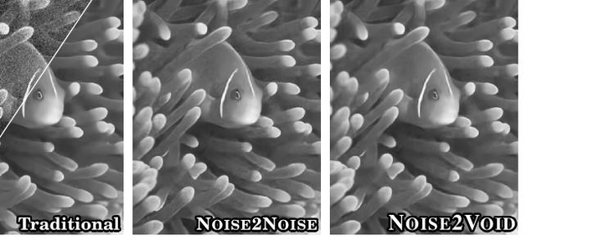
23
DATA BRANCH·NOISE2VOID·2019·BEFORE → AFTER
N2V vs N2N — removing the second photograph
Krull et al., CVPR 2019. Noise2Noise still needs two independent shots of one scene, which rules out anything that moves and every archival image. N2V removes that too — and pays for it.
Traditional, Noise2Noise and Noise2Void training schemes side by side, with N2V single-image blind-spot result on the right. [N2V19 · Fig. 1]
ASPECT | NOISE2NOISE (2018) | NOISE2VOID (2019) | WHY IT MATTERS
Requires | Two noisy shots per scene | One noisy image. That is all. | Applicable to any archive, any moving subject, any single acquisition
Key innovation | Corrupted target with matching mean | Blind-spot receptive field | Prediction for pixel i uses its neighbourhood except pixel i
Why it cannot cheat | Target is independent of input | Noise is conditionally pixel-wise independent, so neighbours carry no information about ni | The identity solution becomes unreachable by construction
N2V19 §3.1, §3.4, §3.5, §4.1, Fig. 4 · N2N18 Table 1
2007
2014
2017
2022
2025

Slide 24
24
DATA BRANCH·NOISE2VOID·2019·BEFORE → AFTER
N2V vs N2N — removing the second photographCONTINUED
ASPECT | NOISE2NOISE (2018) | NOISE2VOID (2019) | WHY IT MATTERS
Implementation change | Swap the target tensor | Replace the centre pixel with a random neighbour; score the loss only there | A masking trick, not an architecture — any standard CNN acquires the property
Performance (BSD68, σ=25) | 28.86 dB | 27.71 dB | −1.15 dB vs N2N, and 0.88 dB below BM3D (28.59 in the same table) — the cost is real and the paper does not hide it
Applications | Burst photography, rendering | Cryo-TEM, fluorescence microscopy, cell tracking | Domains where the paper own figure captions the ground-truth column does not exist
THE HONEST FRAMING — AND THE ONE TO USE IF CHALLENGED
Self-supervision is not a quality technique, it is an availability technique. Where clean data exists, supervision wins by 1.35 dB — the supervised baseline scores 29.06 against N2V 27.71, both numbers from N2V own comparison [N2V19]. Where it does not, the comparison is not 27.71 against 29.06 — it is 27.71 against nothing at all.
BM3D is 28.57 in DnCNN17 Table II and 28.59 in N2V19 comparison — we quote each table own number and never mix the two.
N2V19 §3.1, §3.4, §3.5, §4.1, Fig. 4, results table · N2N18 Table 1
2007
2014
2017
2022
2025

Slide 25
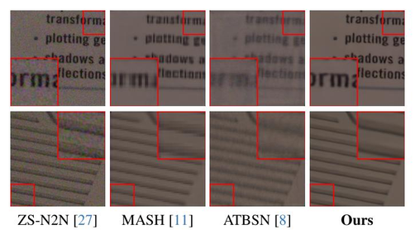
25
DATA BRANCH·ZS-N2N·2023·P2N·2025
Down to one image, then down to no sacrifice
The branch finishes by removing the last two requirements. Compressed into one slide because the pattern is now familiar — each paper removes exactly one thing.
The information-lossy barrier made visible: ZS-N2N, MASH and ATBSN all lose fine structure that P2N renoise-and-agree supervision keeps. [P2N25 · Fig. 2]
ZS-N2N (2023)
P2N (2025)
Requirement removed — The training set. No corpus, no pretraining.
Requirement removed — The information loss itself.
Key innovation — A pair downsampler: two fixed diagonal filters split one image into a noisy pair with similar signal and independent noise.
Key innovation — RDC: renoise the model own output with + and −, giving y+ and y− at full resolution. DCS: train the two denoised results to agree.
Implementation change — Two fixed stride-2 convolutions; a 20,000-parameter two-layer net fitted to that one image; residual + consistency loss.
Implementation change — Three forward passes per step, on tensors that do not exist until the model has run once. Output compared against output, not against a target.
ZS-N2N23 §3, §4 · P2N25 (CVPR 2025) · repository measured
2007
2014
2017
2022
2025

Slide 26
26
DATA BRANCH·ZS-N2N·2023·P2N·2025
Down to one image, then down to no sacrificeCONTINUED
ZS-N2N (2023)
P2N (2025)
Why it is not just a new loss — It is a new input construction.
Why it is not just a new loss — Same: a loss scores a fixed prediction against a fixed target. P2N changes what goes in, how many passes, and which pair is compared.
Cost paid — Half the spatial resolution during training; 1–2 K gradient steps per image.
Cost paid — Three passes per step; still per-image test-time optimisation.
Applications — Single archival images, one-off scientific captures; ~1 min on CPU vs Self2Self 1.2 h on GPU.
Applications — Self-supervised denoising where masking artefacts are unacceptable.
The through-line: the network never moved, the target did.
Clean image (2018)
→
second copy (2019)
→
training set (2023)
→
information loss (2025)
Four papers, four requirements removed, one U-Net throughout.
ZS-N2N23 §3, §4 · P2N25 (CVPR 2025) · repository measured
2007
2014
2017
2022
2025

Slide 27
27
4
BRANCH B · 2021 – 2024
Replacing the Convolution
PART 4 / 5
The evidence for bottleneck 3
01
02
Restormer — attention on a different axis
03
NAFNet — delete the mechanisms
04
SCUNet and MambaIR
05
Why there are several SOTAs
The other debt: a 35×35 receptive field, and three competing operators that fix it.
brief §4
2007
2014
2017
2022
2025

Slide 28
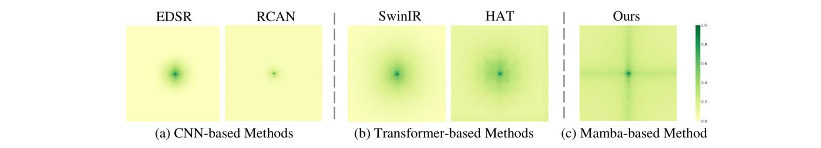
28
ARCHITECTURE·BOTTLENECK 3·THE RECEIPT
One number points to the receptive field as the problem
Identical models, identical table, identical noise level. The only thing that changes is the dataset — and the gain changes by a factor of five.
Effective receptive field: CNNs stay tightly local, Transformers spread further, the Mamba-based backbone activates the widest field. [MambaIR24 · Fig. 1]
+0.39 dB
+1.98 dB
−0.71 dB
BSD68 · Σ=50 · DNCNN → RESTORMER
URBAN100 · Σ=50 · SAME TWO MODELS
BARBARA · Σ=25 · DNCNN VS BM3D · 2017
26.23 → 26.62, blind models, one table. Ordinary natural images, little long-range repetition: five years of architecture research buys almost nothing.
26.35 → 28.33, same table. Photographs of buildings — windows and railings repeating across hundreds of pixels. Five times the gain, on the dataset made of repetition.
The same phenomenon five years earlier, in DnCNN own results — the one Set12 image dominated by repetitive texture.
Restormer22 Table 4 (the four σ=50 numbers, single table) · DnCNN17 Table III
2007
2014
2017
2022
2025

Slide 29
29
ARCHITECTURE·BOTTLENECK 3·THE RECEIPT
One number points to the receptive field as the problemCONTINUED
01
What this suggests. The architecture branch did not make denoising uniformly better. It made denoising better specifically where non-locality matters — which is exactly the capability a 3×3 convolution stack structurally lacks.
02
What it does not prove. The comparison changes several variables at once: capacity, normalisation, and five years of training practice. NAFNet own ablation (slide 32) will show LayerNorm alone is worth +0.44 dB. The honest claim: the gain pattern is consistent with the receptive-field hypothesis — evidence, not proof.
03
Why depth cannot fix it. Receptive field grows linearly with depth: (2d+1)². Reaching WNNM 361×361 the DnCNN way needs about 180 layers. The fix had to be a different operator, not more of the same one.
Provenance: the 0.39-vs-1.98 comparison is our own analysis of published values, both pairs taken from Restormer Table 4 so the protocol is identical. Say computed from Table 4 if challenged.
Restormer22 Table 4 · DnCNN17 Table I, Table III · NAFNet22 §4
2007
2014
2017
2022
2025

Slide 30
30
ARCHITECTURE·RESTORMER·2022·BEFORE → AFTER
Attention becomes affordable by changing one axis
Zamir et al., CVPR 2022. Standard self-attention costs O(W²H²) — a 256×256 image needs a 4.3-billion-entry attention matrix, against 196 tokens for a ViT. Restormer attends over channels instead of pixels.
Restormer/basicsr/…/restormer_arch.py — Attention.forward
01
One einops pattern is the entire complexity claim. Putting pixels on the last axis makes q @ k.transpose(-2,-1) a C×C matrix — 48×48 whether the image is 256² or 4000×3000. Cost becomes linear in pixels.
# BEFORE — spatial attention (ViT / SwinIR)
'b c h w -> b head (h w) c' → q@kT is (HW × HW)
02
Is it really global? Honestly: not pairwise-pixel. Every channel is computed from every pixel, so channel statistics carry image-wide information; the paper says global relationships are implicitly modelled and never claims otherwise.
256×256 → 65,536 × 65,536
# AFTER — Restormer MDTA
q = rearrange(q, 'b (head c) h w -> b head c (h w)',
03
The depth-wise convolutions are load-bearing, not decoration. Removing qkv_dwconv costs 0.15 dB on Urban100 σ=50 — more than most architecture papers gain in total. [Restormer22 Table 7]
head=self.num_heads) # ← pixels on the LAST axis
k = rearrange(k, …); v = rearrange(v, …)
q = F.normalize(q, dim=-1); k = F.normalize(k, dim=-1)
04
Why SOTA: the first method past 40 dB on both real-noise benchmarks — SIDD 40.02 / DND 40.03, the only one to do so in its own comparison table [Restormer22 Table 6]. Leads Urban100 at every noise level [Table 4]; 3.14× fewer FLOPs and 13× faster than SwinIR. Published at CVPR 2022 — how long it held those tables is not something any source states.
attn = (q @ k.transpose(-2,-1)) * self.temperature
# → (C/head × C/head). At level 1: 48 × 48, any image size
measured — swz30/Restormer, verbatim · Restormer22 §1, §3.1, Tables 4, 6, 7
2007
2014
2017
2022
2025

Slide 31
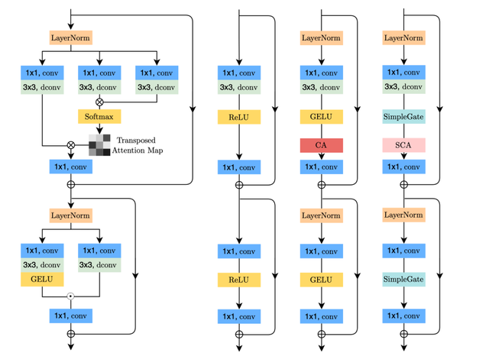
31
ARCHITECTURE · NAFNET · 2022 · BEFORE → AFTER
The paper that asked whether any of it was necessary
Chen et al., ECCV 2022. While everyone added mechanisms, NAFNet removed them and scored higher. Its derivation is the most elegant reasoning in the modern half of this story.
The lineage NAFNet derives in one figure: the transformer block simplified step by step down to SimpleGate and SCA. [NAFNet22 · Fig. 3]
The method: take a standard transformer restoration block and delete every component you cannot justify — the activation, the softmax, the sigmoid. Each deletion is argued from first principles, and each deletion improves the score. [NAFNet22 §4]
measured — megvii-research/NAFNet, verbatim · NAFNet22 §4, §5, abstract
2007
2014
2017
2022
2025

Slide 32
32
ARCHITECTURE · NAFNET · 2022 · BEFORE → AFTER
The paper that asked whether any of it was necessaryCONTINUED
01
The derivation. GELU is a special case of a gated linear unit. But a GLU itself contains nonlinearity: f(X)⊙g(X) is nonlinear because a product of two linear maps is not linear. So delete the activation — the gate already supplies it.
NAFNet/basicsr/…/NAFNet_arch.py
# BEFORE — GELU, then a gate
GELU(x) = 0.5x(1+tanh[sqrt(2/pi)(x+0.044715x³)])
CA(X) = X · sigmoid(W2 relu(W1 pool(X)))
02
Apply the same argument to channel attention and both its nonlinearities vanish too. Result: no Sigmoid, no ReLU, no GELU, no Softmax anywhere — the first work demonstrating that nonlinear activation functions may not be necessary for SOTA computer vision methods. [NAFNet22 abstract]
# AFTER — SimpleGate: the gate IS the nonlinearity
def forward(self, x):
x1, x2 = x.chunk(2, dim=1)
return x1 * x2 # ← replaces GELU entirely
03
Both simplifications improved the score. SimpleGate beats GELU (+0.08 dB), SCA beats CA (+0.03 dB) on SIDD. [NAFNet22 §4]
# AFTER — SCA: no sigmoid, no relu
self.sca = nn.Sequential(nn.AdaptiveAvgPool2d(1),
04
The uncomfortable finding in their own ablation: the largest single gain is LayerNorm, +0.44 dB (39.29 → 39.73) — because it stabilises training at a 10× larger learning rate. A large share of reported architectural progress in restoration is optimisation progress wearing a costume. [NAFNet22 §4]
nn.Conv2d(c, c, 1))
Why SOTA: 40.30 dB on SIDD — the highest real-noise result in our comparison, +0.28 dB over Restormer 40.02 — at less than half the previous best compute. Published at ECCV 2022. And by far the simplest code to maintain. [NAFNet22 abstract]
measured — megvii-research/NAFNet, verbatim · NAFNet22 §4, §5, abstract
2007
2014
2017
2022
2025

Slide 33

33
ARCHITECTURE · SCUNET · 2023 · MAMBAIR · 2024
Two more answers — one architectural, one not about architecture at all
The branch does not end with Transformers. MambaIR proposes a different operator again; SCUNet argues the operator was never the problem.
The Swin-Conv-UNet pipeline: swin-conv blocks combine local and non-local modelling on the way down and back up a UNet backbone. [SCUNet23 · Fig. 1]
MAMBAIR (2024)
SCUNET (2023)
The claim — Attention is quadratic; windowing surrenders globality. Borrow a selective state-space model — global receptive field at linear cost.
The claim — The benchmark is the problem. A model trained on AWGN performs poorly for most of real images due to noise assumption mismatch.
Technical change — S6 recurrence with input-dependent B, C, Δ. Dual form: recurrent (unbounded memory) for reach, convolutional for parallel training.
Technical change — Keep local and non-local priors in parallel: split the feature map, half to a Swin block, half to a residual conv block.
MambaIR24 §3.1, §3.2, Tables 1, 2, 6 · SCUNet23 abstract, §1, §3.1, §3.2 · measured
2007
2014
2017
2022
2025

Slide 34
34
ARCHITECTURE · SCUNET · 2023 · MAMBAIR · 2024
Two more answers — one architectural, one not about architecture at allCONTINUED
MAMBAIR (2024)
SCUNET (2023)
Implementation change — Flatten the image to a sequence; four-directional scan; add a local conv (fixes local pixel forgetting) and channel attention (fixes redundancy).
Implementation change — The dataloader becomes the contribution: Gaussian, Poisson, speckle, JPEG and sensor noise synthesised through a real inverted ISP, plus resizing and double degradation.
Why SOTA / where — Best DND result, 40.04 dB — by 0.01 dB over Restormer 40.03 [MambaIR24 Table 6]. Leads super-resolution on Manga109 ×2 by 0.41 dB over SwinIR.
Why SOTA / where — Trained purely on synthetic mixed degradation (no SIDD/DND pairs). Among blind models on standard colour denoising it edges Restormer where non-locality matters: Urban100 σ=50 30.14 vs 30.02, CBSD68 σ=50 28.61 vs 28.60 [SCUNet23 comparison table]. Not top of any AWGN leaderboard — and it does not need to be.
Cost / limitation — Will not import without compiled CUDA extensions. Its own changelog records that published thop complexity figures were wrong; the denoising model parameter count is not reported in the paper. [measured]
Cost / limitation — 9.66 M parameters, smallest of the four, built to survive real photographs. Its abstract still concedes a general-purpose blind real denoiser remains unsolved.
MambaIR24 §3.1, §3.2, Tables 1, 2, 6 · SCUNet23 abstract, §1, §3.1, §3.2, blind comparison table · measured
2007
2014
2017
2022
2025

Slide 35
35
PRACTICAL DEEP-DIVE · FROM CHECKPOINT TO OUTPUT
The prior is a file — the whole pipeline in practice
What the brief calls the practical half: the data pipeline, the loss functions that create the file, and the three lines that load it back.
THE LOSS THAT CREATES THE FILE — one row per era
loading the pretrained prior
ERA | DATA | LOSS
Supervised — DnCNN, Restormer, NAFNet | pairs (y, x): synthetic AWGN or real SIDD pairs | ‖R(y) − (y−x)‖² or L1
Noise2Noise | pairs (y1, y2): two noisy shots | same MSE — targets swapped
Noise2Void | single noisy y | MSE scored only at masked centre pixels
ZS-N2N | one image → two downsampled views | residual + consistency loss
P2N | model output renoised ± | agreement loss — no target at all
# 1 — the prior is a 2.7 MB file (0.67 M params, fp32)
net = DnCNN(in_nc=1, out_nc=1, nc=64, nb=17, act_mode=R)
ckpt = torch.load('dncnn_sigma25.pth', map_location='cpu')
net.load_state_dict(ckpt)
net.eval() # freeze batch-norm statistics
# 2 — one noisy image through the trained prior
y = torch.from_numpy(img).permute(2,0,1).unsqueeze(0)/255.
with torch.no_grad(): # no optimisation at test time
n = net(y) # R(y): the noise, learned
out = (y - n).clamp(0,1) # x = y - R(y) → return x-n
# 3 — Hugging Face variant, same pattern:
# from huggingface_hub import snapshot_download
# path = snapshot_download(repo_id) # → local .pth
Every era of this talk in one line: classical = solve an optimisation per image; deep = load_state_dict once, forward in 60 ms; self-supervised = the same file, fitted to one image.
cszn/KAIR, verbatim · DnCNN17 §II-B · N2N18 Eq. (2)–(6) · N2V19 §3.4 · ZS-N2N23 §3 · P2N25 §3 · huggingface_hub docs
2007
2014
2017
2022
2025

Slide 36
36
5
SYNTHESIS · 2007 – 2025
Why There Is No Single Winner
01
The SOTA comparison table
PART 5 / 5
02
The same crop through every era
03
Why several coexist
04
Applications and trade-offs
05
Open problems and proposals
The question this talk was built to answer, now with the numbers behind it.
brief §6
2007
2014
2017
2022
2025

Slide 37
37
SYNTHESIS · SOTA COMPARISON
Six methods — each leads a different table
Every row names the benchmark and the metric — a claim without those is not checkable. Quality figures reproduced from published tables; parameters and CPU latency are our own measurements.
METHOD | LEADS ON | HEADLINE FIGURE | PUBLISHED | WHAT DISTINGUISHES IT | COST
NAFNet (2022) | SIDD — real sensor noise | 40.30 dB | ECCV 2022 | No attention, no activation functions at all; simplest code | 116.0 M · 1.90 s CPU
Restormer (2022) | Urban100 — long-range structure | σ=50: 28.33SIDD 40.02 / DND 40.03 | CVPR 2022 | First past 40 dB on both real-noise benchmarks; channel attention at linear cost | 26.1 M · 10.44 s CPU
MambaIR (2024) | DND — held-out real noise | 40.04 dB (+0.01) | ECCV 2024 | Global receptive field at linear cost via selective state-space scan | CUDA-compiled ext. to import; DN params not in paper
SCUNet (2023) | Its own blind mixed-noise benchmark — no standard table | Urban100 σ=50: 30.14top among blind models | Mach. Intell. Res. 2023 | Competes on the training distribution, not the architecture | 9.7 M · 1.69 s CPU
DnCNN (2017) | Historical — BSD68 Gaussian | 29.23 dB (σ=25) | IEEE TIP 2017 | The reference the whole field was built against | 0.67 M · 1.02 s CPU
BM3D (2007) | Zero-shot — no training data | 28.57 dB (σ=25) | IEEE TIP 2007 | No training, no GPU; still the zero-shot baseline in N2N18, N2V19, ZS-N2N23 | No training · 2.85 s
No source states a SOTA window, so this deck does not assert one. Read the Leads-on column: these methods are not ranked on one axis — they lead different benchmarks, and those benchmarks measure different capabilities.
NAFNet22 abstract · Restormer22 Tables 4, 6 · MambaIR24 Table 6 · SCUNet23 · DnCNN17 Table II · measured [Stage 2]
2007
2014
2017
2022
2025

Slide 38
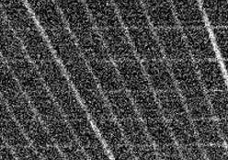
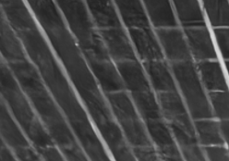
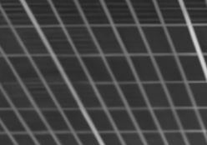
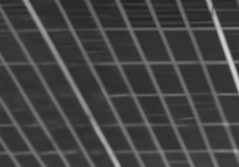

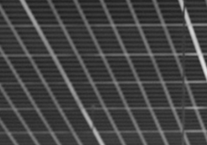

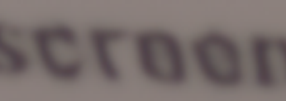
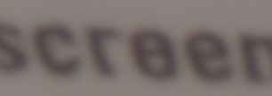
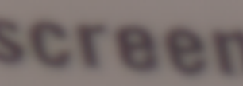
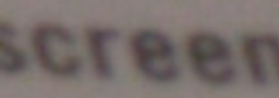
38
SYNTHESIS · QUALITATIVE COMPARISON
The same crop through every era
Quantitative tables rank; crops reveal. Two published comparisons, one image each — every tile reproduced verbatim from the cited figure.
GAUSSIAN DENOISING — ONE CROP, FOUR GENERATIONS · [RESTORMER22 · FIG. 6, TOP ROW]
NOISY INPUT
DnCNN · 2017
DRUNet · 2021
SwinIR · 2021
RESTORMER · 2022
GROUND TRUTH
REAL SENSOR NOISE — SIDD · [NAFNET22 · FIG. 5]
NOISY · 19.01 dB
MPRNet · 34.96
RESTORMER · 35.01
NAFNET · 35.77
GROUND TRUTH
01
The top row is the architecture branch made visible: as the receptive field widens (slide 28), the repeating texture returns — DnCNN leaves it smooth, DRUNet and SwinIR recover part of it, Restormer restores it.
02
The bottom row is the real-noise story: 0.8 dB separate MPRNet from NAFNet in PSNR, but the texture difference is what a practitioner sees first — the case slide 5 made for reporting SSIM and LPIPS alongside PSNR.
03
Method note: crops are reproduced verbatim from the published figures cited below — same image per row, no cherry-picking on our side.
Restormer22 Fig. 6 (top row) · NAFNet22 Fig. 5 — tiles reproduced from the published figures
2007
2014
2017
2022
2025

Slide 39
39
SYNTHESIS · WHY SEVERAL SOTAS
Four reasons the field has not converged on one method
This is the question the professor is most likely to ask, so it gets its own slide rather than a sentence.
REASON 1
REASON 2
The benchmarks measure different things
The cost axes disagree with each other
BSD68 measures average-case Gaussian removal and has saturated: +0.35 dB across five years at σ=25 (DnCNN-B 29.16 → Restormer 29.51, both blind models, one table [Restormer22 Table 4]). Urban100 measures long-range self-similarity; SIDD and DND measure real sensor noise. A method can lead one and trail another without any contradiction.
Our own measurements give three incompatible rankings of the same models: by parameters DnCNN wins; by CPU wall-clock the P2N backbone wins; by real-noise quality NAFNet wins. NAFNet has 4.4× Restormer parameters and runs 5.5× faster. More efficient is meaningless without naming the metric and the device.
REASON 3
REASON 4
Deployment constraints are not quality constraints
Supervision availability partitions the field
MambaIR leads DND by 0.01 dB and cannot be imported without compiled CUDA extensions. SCUNet leads no standard leaderboard and is a third of Restormer size. Which one is best depends entirely on what you are shipping onto what hardware.
Branch A and branch B answer different questions. Where clean pairs exist, supervision wins by 1.35 dB — 29.06 vs 27.71, both numbers from N2V own comparison [N2V19]. Where they do not, the self-supervised methods are not worse — they are the only option, and the supervised SOTA is simply unavailable.
Restormer22 Table 4 · NAFNet22 · MambaIR24 · N2V19 results table · measured
2007
2014
2017
2022
2025

Slide 40
40
SYNTHESIS · APPLICATIONS AND TRADE-OFFS
What you would actually deploy, and why
The honest answer to which is best names the constraint first. Five constraints, five different answers, all current — which is what an unresolved research question looks like when you have to ship something.
IF YOUR CONSTRAINT IS… | DEPLOY | BECAUSE | ACCEPT
Real photos, GPU, paired data | NAFNet | 40.30 dB on SIDD; best accuracy-per-millisecond we measured; simplest code to maintain | 116 M parameters
Repetitive structure, max quality | Restormer | Leads Urban100 at every σ [Table 4]; first method past 40 dB on both real-noise benchmarks (SIDD 40.02 / DND 40.03) | 10.4 s per 256² on CPU
CPU or memory bound | SCUNet | 9.7 M parameters; synthetic-degradation training survives resized and JPEG-compressed input | Not top of any AWGN leaderboard
No clean data exists at all | P2N / ZS-N2N | Microscopy, cryo-EM, astronomy — where ground truth cannot be acquired | Per-image test-time optimisation
No data, no GPU, no dependencies | BM3D | Seventeen years old and still beats AWGN-trained DnCNN on real noise by 1.99 dB [Restormer22 Table 6] | 2.85 s, and a quality ceiling
Denoising is rarely the product: it is preprocessing for detection and segmentation — where the metric that matters is downstream IoU (slide 5) — and a plug-and-play prior inside other solvers. [SCUNet23 §1 · DnCNN17 §III-D]
NAFNet22 · Restormer22 Tables 4, 6 · SCUNet23 · P2N25 · ZS-N2N23 · measured
2007
2014
2017
2022
2025

Slide 41
41
SYNTHESIS · OPEN PROBLEMS
What eighteen years did not solve
Each of these is grounded in a documented limitation from the papers themselves or in our own measurements — not speculation.
OPEN 1
OPEN 2
A blind denoiser for real cameras
Fidelity metrics reward blur
SCUNet abstract states it remains unsolved. Neither synthetic degradation nor SIDD-trained models generalise to an unseen camera with an unseen ISP, and no benchmark currently measures that. DnCNN scores 23.66 dB on SIDD [Restormer22 Table 6] — 5.6 dB below its own BSD68 score, and 16.4 dB behind Restormer 40.02 in the same table. Synthetic training does not survive contact with real sensor noise: a cliff, not a graceful degradation.
Every loss in the modern field is L1, L2 or PSNR, and all three recover a conditional mean — which is smoother than any plausible clean image. Noise2Noise names the mechanism itself: L2 training results in spatial blurriness. While leaderboards rank by PSNR, the incentive points the wrong way. [N2N18 §2]
OPEN 3
OPEN 4
Nobody agrees what efficient means
The benchmarks have saturated
Three incompatible rankings from our own measurements, and MambaIR changelog concedes its published complexity figures were wrong. Efficiency claims across papers are close to uncheckable.
At σ=50, BSD68 moved 0.39 dB in five years while Urban100 moved 1.98 — five times as much [Restormer22 Table 4]. On SIDD, the DnCNN-to-Restormer gap in one table is 16.4 dB [Restormer22 Table 6]. A benchmark that cannot distinguish 2017 from 2022 is no longer measuring what the field works on.
SCUNet23 abstract · Restormer22 Tables 4, 6 · N2N18 §2 · measured
2007
2014
2017
2022
2025

Slide 42
42
SYNTHESIS · PROPOSAL DIRECTIONS
Four research directions the limitations actually justify
Each is tied to a specific documented gap, states what would change, and names how it would be measured. None of these claims a paper achieved something it did not.
DIRECTION | GROUNDED IN | WHAT WOULD CHANGE | HOW YOU WOULD MEASURE IT
Cross the fork: self-supervised supervision on a modern backbone | Our own finding — no published work trains a Transformer or SSM backbone under RDC/DCS supervision; P2N still ships the 2018 U-Net | Replace UNet_n2n_un with a Restormer or NAFNet block under P2N RDC/DCS training signal | N2V own protocol on BSD68 σ=25 and on cryo-TEM / CTC sets — does the 1.35 dB gap (slide 24) shrink?
Cross-ISP generalisation benchmark | SCUNet abstract: a general blind real denoiser remains unsolved, and no benchmark tests unseen cameras | Train on SIDD, evaluate on DND and a held-out camera; report the drop as the headline number | Δ PSNR between seen and unseen ISP — a metric nobody currently reports
Perceptual objective without losing fidelity | Noise2Noise names L2 spatial blurriness; perceptual losses are common in SR and absent from denoising | Add an LPIPS or no-reference term to NAFNet PSNR loss; report both axes, not one | PSNR and LPIPS jointly on SIDD — accept a small dB loss for a measured perceptual gain
An efficiency protocol the field can agree on | Three incompatible rankings from our measurements; MambaIR corrected thop figures | Report parameters, MACs and wall-clock on a named device, with the counting method stated explicitly | Reproduce the table across CPU and GPU; the ratio changes are themselves the result
The first row is the one we would pursue. It falls directly out of the structural claim of this project — the two branches have never merged — and it is cheap to test, because both halves already exist as working code.
grounded in P2N25, SCUNet23 abstract, N2N18 §2, MambaIR24 changelog, and our own measurements
2007
2014
2017
2022
2025

Slide 43
43
CONCLUSION
The evolution, in one paragraph
Denoising is the cleanest case study in how computer vision replaced hand-designed priors with learned ones, because here the prior is written down explicitly and you can watch it move.
Four eras, three bottlenecks. Manual prior design ended when DnCNN made the prior a downloadable file. That created two new debts — it needed clean data, and it could only see 35 pixels — and in 2018 the field forked to pay them off separately.
Neither branch has adopted the other advance. And because three architectures now lead three different benchmarks while none solves real-camera generalisation, the story ends in an open question rather than a winner.
— What the evidence in this talk supports.
the organising claim, carried since Stage 1 · evidence: DnCNN17 · N2N18 · N2V19 · Restormer22 · NAFNet22 · SCUNet23 · MambaIR24
2007
2014
2017
2022
2025

Slide 44
44
BACKUP · THE MATHEMATICS IN ONE PLACE
Every equation this talk leaned on
Kept for the defence: the formulas named on the method slides, written as equations with their sources.
MAP — THE CLASSICAL PRIOR
WNNM — WEIGHTED NUCLEAR NORM
DnCNN — RESIDUAL LEARNING
x̂ = argmin_{x} ½‖y − x‖² + λ·Φ(x)
X̂ = argmin_{X} ½‖Y − X‖²_{F} + Σ_{i} w_{i}·σ_{i}(X), w_{i} ∝ 1/σ_{i}
ℓ(Θ) = 1/2N Σ_{i} ‖R(y_{i}; Θ) − (y_{i} − x_{i})‖²
The prior written down: explicit, differentiable, arguable.
The network learns v, not x; the output is y − R(y).
[DnCNN17 §I]
Large singular values carry the image and are shrunk less.
[DnCNN17 Eq. (1)]
[WNNM14 §3, Thm 2]
NOISE2NOISE — THE THEOREM
RESTORMER — MDTA
MAMBA — S6 RECURRENCE
argmin_{θ} E‖f(y;θ) − z‖² ⇒ f* = E[z|y]; E{z′} = E{z} ⇒ same optimum
Attn = softmax(τ·QK^{T}) ∈ ℝ^{C×C}, out = V·Attn^{T}
h_{t} = Āh_{t−1} + B̄_{t}·x_{t}, y_{t} = C_{t}·h_{t}; Ā = exp(Δ_{t}·A), B̄_{t} = Δ_{t}·B_{t}
A zero-mean corrupted target is as good as a clean one.
Pixels on the last axis: attention over channels, cost linear in HW.
Selective state space: Δ, B, C are input-dependent — global reach at linear cost.
[N2N18 Eq. (2)–(6)]
[Restormer22 §3.1]
[MambaIR24 §2 · Gu & Dao 2023]
all equations reproduced from the cited sections · SSIM and LPIPS definitions: slide 05
2007
2014
2017
2022
2025

Slide 45
45
BACKUP · QUESTION INDEX
Where to find the answer to what you are about to be asked
Kept for the Q&A. The full evidence for every claim in this talk is in the 100-slide master deck, indexed here by the question likely to prompt it.
IF ASKED… | ANSWER IN ONE LINE | MASTER DECK
Why is 0.6 dB a big deal? | Seven years of classical refinement bought +0.11–0.39 dB over BM3D at σ=25; DnCNN took +0.66 dB in one paper [DnCNN17 Table II] | 10, 37
Why predict noise, not the image? | y is closer to x than to v, so learning the image forces an identity mapping — the hard point in parameter space | 33
Why do RL and BN need each other? | RL makes layer inputs Gaussian-like and content-independent — what BN batch statistics assume | 34
Why depth 17? | RF = (2d+1)² set to 35×35 to match EPLL, the smallest effective patch size in the field | 35
How can noisy targets work? | L2 learns the conditional mean; the mean of a zero-mean corrupted target is the clean target | 43
Where is Restormer attention linear? | Attention.forward — the rearrange puts pixels last, so q@kT is C×C not HW×HW | 69
Why is NAFNet faster with more parameters? | 1×1 and depth-wise convs hit optimised GEMM paths; rearrange forces tensor-layout changes | 77
What did the code tell you that the papers did not? | Padding constants differ 8×; SPI cuts parameters and triples latency; MambaIR needs CUDA to import | 75, 77
Which would you deploy? | Name the constraint first — five constraints, five answers, all current | 89
Did you verify the PSNRs yourself? | No. Every quality figure is reproduced from a named published table; only parameters and latency are ours | 81, 93
Where are the equations? | Slide 44 of this deck — WNNM, MDTA, S6 and the rest in one place | this deck, 44
The rule for the defence: do not put anything on a slide you cannot personally explain. Every claim in this talk traces to a named table in a named paper, or to a measurement whose method is stated.
Q&A index · master-deck numbers refer to the 100-slide deck submitted separately
2007
2014
2017
2022
2025

